Slide 1
Notes:
It’s my pleasure to speak to you today about research on HIV-related stigma across the UTT trials

Slide 2
Diverse questions and approaches across trials
Stigma ⇒ UTT
Does HIV-related stigma limit the effectiveness of ‘test and treat’ interventions? If so, how?
UTT ⇒ Stigma
Do ‘test and treat’ interventions reduce (or increase) HIV-related stigma? If so, how?
Notes:
There are diverse questions posed and diverse approaches taken to the study of stigma and test and treat
But if I had to boil them down there are two main sets of questions:
The first is about the effect of stigma on test and treat: Does HIV-related stigma limit the effectiveness of ‘test and treat’ interventions? If so, how?
The second is about the effect of test and treat on stigma:
Do ‘test and treat’ interventions reduce (or increase) HIV-related stigma? If so, how?

Slide 3
Overview
HPTN 071 (PopART Intervention)
Sustainable East Africa Research in Community Health (SEARCH)
Botswana Combination Prevention Project (BCPP)/YaTsie
ANRS 12249 Treatment as Prevention (TasP) Study
Notes:
Here is the order of this presentation:
The PopART Intervention in Zambia and South Africa
SEARCH, in Kenya and Uganda
The Botswana Combination Prevention Project /YaTsie
and the TasP Study in KwaZulu-Natal, South Africa

Slide 4
PopART Stigma Ancillary Study
Hypotheses
HPTN 071 (PopART) intervention may change levels of HIV-related stigma
HIV-related stigma may undermine effectiveness of the HPTN 071 (PopART) intervention
HIV-related stigma may be changed by UTT as it rolls out
Notes:
Additional funding was obtained for an ancillary study that focused on stigma in PopART. The study is investigating three hypotheses about whether the PopART intervention reduces, increases and/or changes HIV stigma.

Slide 5
PARALLEL
ASSESSMENTS
OF
STIGMA
The Community
Qualitative Cohort + Population Cohort + Case Control
People living with HIV
Survey +
Qualitative Cohort +
Population Cohort +
Case Control
Vulnerable populations
Qualitative Cohort & IDIs
Health Workers
Survey +
Qualitative Cohort + IDIs
Notes:
PopART is conducting “parallel assessments” of stigma from multiple perspectives. They are investigating stigma in multiple populations and settings, using comparable qualitative and quantitative measures.

Slide 6
Baseline Stigma prevalence in PLHIV (n=3859)
HIV stigma outcomes | Total | South Africa (n=1704) | Zambia (n=2155) | P
Current internalised stigma Responding Agree or Strongly Agree to any of 3 items | 868 (22.5%) | 310 (18.2%) | 558 (25.9%) | <0.001
Experienced any stigma in past year Responding Once, A few times or Often to any of 5 items | 853 (22.1%) | 320 (18.8%) | 533 (24.7%) | <0.001
Experienced health setting stigma in past year Responding Once, A few times or Often to any of 3 items | 280 (7.3%) | 148 (8.7%) | 132 (6.1%) | 0.002
Any stigma last year Yes to current internalised stigma, experienced any or health setting stigma in last year | 1371 (35.5%) | 503 (29.5%) | 868 (40.3%) | <0.001
Notes:
Among people living with HIV in the study population, baseline stigma was high, at 30 to 40%. Levels of stigma significantly differed between SA and Zambia, with Zambia higher on many measures.
Items for the measurement of internalized stigma included “ I lost respect or standing”, “I think less of myself” and “I felt ashamed” because of my status.
Items to measure the experience of stigma included “people talked badly about me because of my status”, I was “physically assaulted”, people would “not sit near me”, or “someone else disclosed my status without my permission”

Slide 7
Negative attitudes towards key populations high at baseline
I would be ashamed if:
Notes:
The team found high levels of negative attitudes towards key populations at baseline, among health workers. This was particularly pronounced in Zambia.
The highest levels of shame were reported towards MSM and women who sell sex.
However, most of these health workers also said they would NOT deny these groups HIV services.

Slide 8
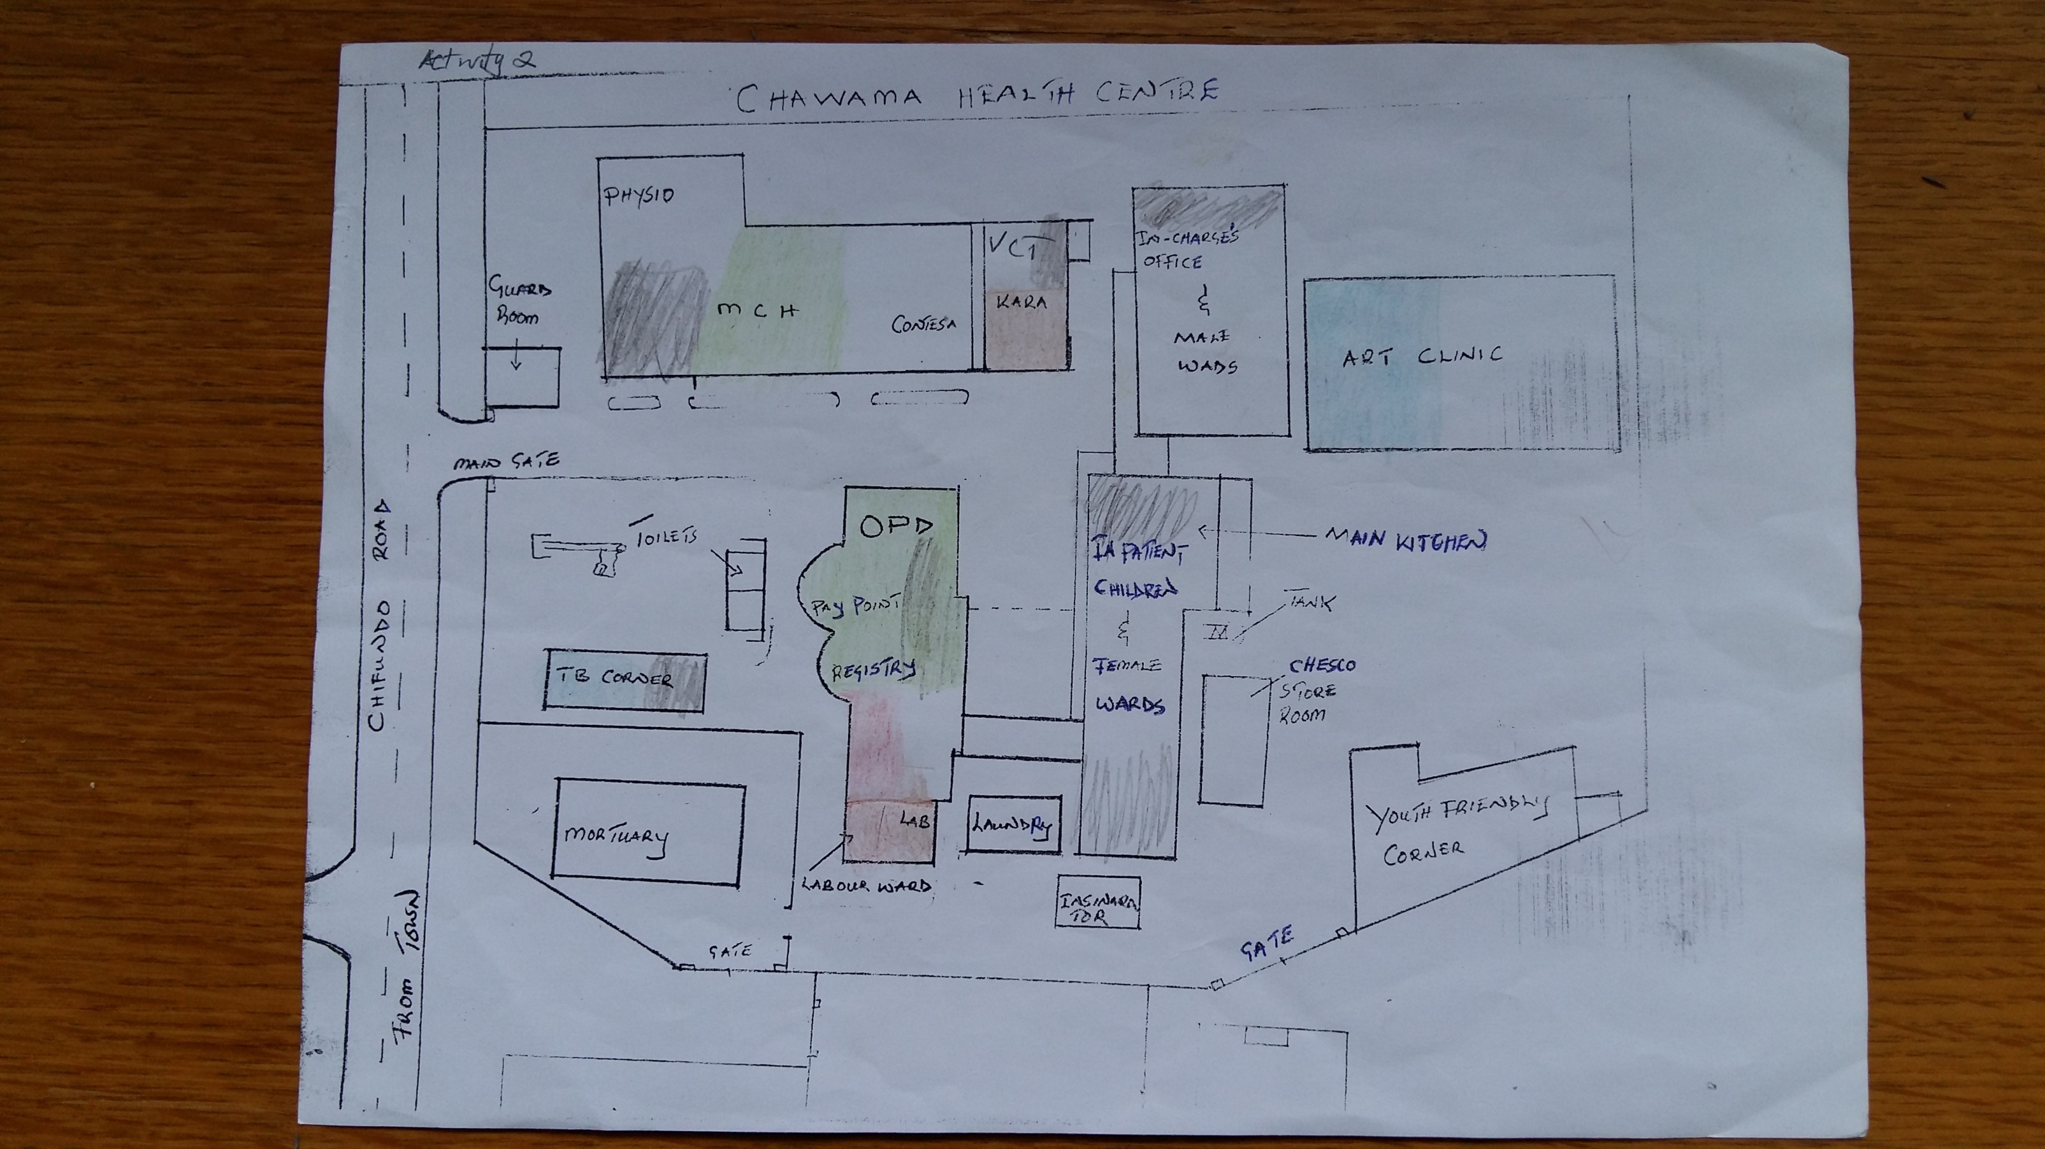
The link between health facility space and stigma
Map of a Health Facility reflecting areas of comfort, discomfort and being talked badly about
Notes:
Health workers were asked about the link between health facility space and stigma. This map of one health facility was coloured by a health worker participant to identify where they thought clients living with HIV felt more or less comfortable and where they were talked badly about. In this map, the ART clinic and TB corner are identified as areas of comfort, the outpatients department and mother to child health clinic as areas of discomfort, and the labour ward as an area where clients living with HIV were talked badly about.
Across the 21 health facilities, the overall findings indicated that space demarcated for HIV services could be either comfortable or uncomfortable. Some health facilities had made changes to reduce the identification of clients living with HIV, including building privacy walls and integrating HIV care with other services.

Slide 9
High levels of self stigma amongst Health Workers Living with HIV at baseline
Self-reported HIV-positive status amongst health workers:
  15.3% to 28.5% in Zambia
  8.3% to 19.6% in South Africa
Internalised stigma higher in Zambia amongst health facility workers
Health facility workers more closed than community health workers
Notes:
A significant proportion of health workers in both countries are living with HIV, as reflected in these figures about self-reported HIV status.
Qualitative research revealed significant challenges to accessing services faced by health workers living with HIV-- especially those with more education and who have a higher professional status.
Health workers living with HIV have developed different strategies to keep their status hidden from co-workers and clients, and fear having their HIV status used against them by both.
There is a desperate irony that health workers who are the face of delivering HIV services are themselves struggling to access them– this is not often talked about, but requires urgent attention and interventions.

Slide 10

Sustainable East Africa Research in Community Health
Qualitative research aim: Compare over time, and across trial arms, how UTT influences changes in beliefs, attitudes and behaviors related to HIV
  Inform adaptations, assess consequences, elucidate pathways of intervention action
  Design
In 8 of 32 communities in Kenya & Uganda participating in SEARCH
Annual in-depth interviews in 3 cohorts:
  community members (HIV+ & HIV-)
  community leaders
  health care providers
Annual FGDs & observations at CHCs
E Uganda
(10 communities)
W Kenya
(12 communities)
SW Uganda
(10 communities)
Notes:
SEARCH includes an embedded longitudinal qualitative research component with the overall aim to compare, over time, and across trial arms, how UTT influences changes in beliefs, attitudes and behaviors related to HIV
The study has been designed to Inform adaptations, assess consequences (both positive and negative), and to elucidate pathways of intervention action
We’ve been doing this work in 8 of 32 communities in Kenya & Uganda participating in SEARCH
Annual in-depth interviews in 3 cohorts: community members (HIV+ & HIV-), community leaders, and health care providers
Annual FGDs & observations at CHCs
************
*Randomly selected community members further stratified by HIV status (5 HIV negative and 9 HIV PLWHV per community)
** community leader HIV status is unknown, selected based on role in the community and involvement in SEARCH mobilization activities
Follow up year 1 notes: (n=4 not included due to death, out-migration, LTFU or declines- 1 HIV- ve replacement). (1 leader LTFU, replaced in follow up year 1)
Follow up year 2 notes: (n=5 not included since follow up year 1 due to death, out-migration, LTFU or declines- no replacements)

Slide 11
Analysis Methods
3 annual rounds (2014 – 2017) of interview data collected from 2 cohorts
1: Team-based coding of n = 419 transcripts
Cohort | Baseline year |  |  |  | Follow up year 1 |  |  |  | Follow up year 2
Community members | n = 112 |  |  |  | n = 108 |  |  |  | n = 103
 | Male 47 | Female 65 | HIV + 70 | HIV - 42 | Male 45 | Female 63 | HIV + 65 | HIV - 43 | Male 44 | Female 59 | HIV + 63 | HIV - 40
Community leaders | n = 32 |  |  |  | n = 32 |  |  |  | n = 32
 | Male 20 |  | Female 12 |  | Male 19 |  | Female 13 |  | Male 19 |  | Female 13
2: Inductive case-level coding to indicate direction of changes in stigma
    ⬄same increasing  decreasing
3: Analysis of pathways of stigma reduction (+ contradictions/deviant cases)
Notes:
Constructivist grounded theoretical / case study approach

Slide 12
Dimensions of Stigma
Pathways of reduction
Underlying drivers
<- - Social Norms - - Subjective Norms - ->
Internalized stigma
➤ Reduced fear of dying / increased optimism
➤ Restored social ‘value’ & role fulfillment via productivity
ART efficacy (improved community-wide ‘coverage’)
Perceived / anticipated stigma
➤ Positive experiences with HIV status disclosure
➤ Increased social support & ‘solidarity’ with other PLHIV
HIV testing: more disclosures
Visibility at clinics (care-seeking closer to home)
Enacted stigma
➤ Power of appearance / healthy bodies: fears (infection, death, ‘sin’) no longer elicited
➤ No longer socially normative to stigmatize PLHIV
Intervention messaging
Anti-discrimination laws
Mass media

Slide 13
Power of appearance / healthy bodies
HIV+ woman, E Uganda
Year 1
Some people like to laugh at us, the HIV positive people. They say, “that person is about to die”… “dead bodies!, you are dead people!”
⇩
Year 3
They look at [HIV] as a normal disease, and not complicated like it used to be […] because they see HIV positive people looking healthy and energetic like them.

Slide 14
Power of appearance / healthy bodies
HIV+ man, Kenya
Year 1
People will say “[so-and-so] is nowadays on drugs, and can’t you see how he looks?” This issue of “how he looks” is what many are trying to avoid, and for one to disclose, he must be a very close friend.
⇩
Year 3
The community doesn’t look down on me [. . .] because the drugs [ARVs] help a lot. From the look of your body, [you] can tell that it’s good. Most of the people who use that drug, their bodies are looking good.

Slide 15
More disclosures / positive experiences with disclosure
HIV+ woman, Kenya
Year 1
When I came here, I found that people really hide their status from the others. They would not want anybody to know that they are taking ARVS.
⇩
Year 3
Let me tell you, now, people are trying to share their HIV status. [A relative said] “HIV is all over… It is something that should not be kept as secret. Everybody has it, everybody is on ARVs. People should just share their status.” He is really open [...] Even the lady I am staying with is very open about her status.

Slide 16
No longer socially normative to stigmatize PLHIV
HIV- woman, SW Uganda
Year 1
I think it is brought about by prostitution and promiscuity, do you think that if you are not disorganized you get that illness? It is a disease that you bring upon yourself; it is not like measles that you just get.
⇩
Year 3
They no longer treat them badly […] because they came to know that the disease is for everyone, and you are not supposed to mistreat another person. How do you harass another person when you know that you are also like that? It’s like getting measles.

Slide 17

BCPP Qualitative Study on Barriers to and
Facilitators of Linkage to Care and ART Initiation
Participants and Recruitment
HIV-positive adult cohort members in communities randomized to receive intervention package, including expanded ART (N=49)
  Eligible for ART, and referred to care at time of enrollment to cohort
  Purposive sampling used to select those who had and had not linked or started ART ~1 year later; n= 6 of 49 had not yet initiated ART at the time of interview
Healthcare providers in the same communities (N=15)
Methods
Individual in-depth interviews & Focus group discussions
Phenomenological paradigm

Slide 18
BCPP Qualitative Findings on Barriers to and
Facilitators of Linkage to Care and ART Initiation
Barriers identified in setting of high ART coverage
  Segregation of care and service delivery: patients inconvenienced and stigmatized by separately designated locations and days of service; especially for highly mobile
  Non-acceptance of HIV status, non-disclosure, lack of family support, religious beliefs
Facilitators
  Support from healthcare providers, including home visits provided by study counselors
  Social support
  Knowing benefits of ART
More men could be reached by visits to their work / social spaces
Addressing structural barrier of segregated service delivery, which persists even in context of high ART uptake, could help reach untreated individuals

Slide 19
Overall research question
Did TasP (with large-scale implementation of repeat home-based HIV testing campaigns, & HIV-specific mobile clinics) increase stigma towards HIV-infected people in rural KZN, or contribute to normalization of HIV and greater acceptance of PLHIV?
Specific objectives
Measure the evolution of stigma perceptions at community-level during course of the TasP trial
Assess the factors associated with stigma perceptions at community-level at the end of the trial

Slide 20
Methods
Social science research programme embedded in TasP; mixed methods (Orne-Gliemann et al BMC Publ Health 2015)
Repeat cross-sectional home-based survey, every 6 months between 2012 and 2016, in Hlabisa sub-district
Interviewer-administered questionnaire (socio-demographics, sexual behaviours, attitudes to HIV testing and stigma)
Variables of stigma perception:
  Do people in your community blame people for having HIV?
  Do people in your community avoid people with HIV?
Start of trial: mid-2012 for 4, 2013 for 6, and 2014 for 10 clusters
End of trial: June 2016

Slide 21
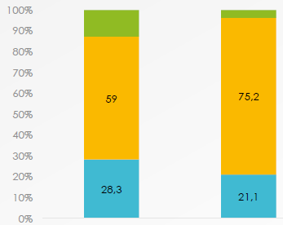
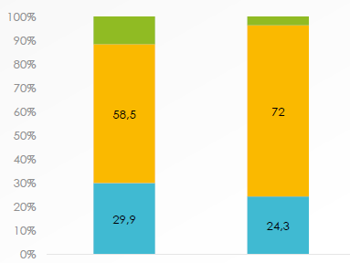
1. Evolution of stigma perception: decline over course of trial
People in your community
blame people for having HIV
People in your community
avoid people with HIV
12.7
3.7
11.6
3,7
Don’t know
59.0
75.2
Disagree
58.5
72,0
p<0.001
p<0.001
28.3
21.1
Agree
29.9
24,3
Start trial
N=15,616
End trial
N=12,906
Start trial
N=15,616
End trial
N=12,906
2. Factors associated with perceived stigma* at the end of the trial
Being HIV+
Not knowing an HIV+ individual
Having been tested for HIV in the last 6m (versus >1 years)
Being engaged/married
*Statistically significant (p<0.001) associations with both stigma perception variables
Notes:
The p<0.001 presented in the first part between the charts indicate how significant is the change of stigma perception between the start and the end of the trial, for each of the two stigma variables. We used Chi2 tests to compare before/after distribution.
You can see that the number of people perceiving stigma decreased for the two stigma variables between the start and the end of the trial. And this decrease is significant.
For the second part, we explored factors associated with stigma perception at the end of the trial using multivariable logistic regressions (one regression for each of the stigma variables). On this slide, we only present the variables significantly associated with both of the two stigma variables (each of these associations had a p<0.001).

Slide 22
Cross-Trial Conclusions
Heterogeneous levels of underlying HIV-related stigma at baseline across trials, and across settings within trials
UTT implementation and uptake hampered by stigma
  strategies that account for/respond to stigma can facilitate UTT
Supportive evidence of declines in stigma in some settings
  plausibility that UTT could accelerate secular declines in stigma due to increasing testing and treatment coverage, via specific pathways
Future efforts should tap synergy of UTT & stigma reduction
Notes:
Cross-Trial Conclusions

